Slide 1
Introduction
Machine Learning (ML) by looking at the definition, we can say that it is a field of computer science. The telecommunications sector has become one of the main industries in developed countries.

Slide 2
Problem Statement
•Customer retention means that the company is having the ability to turn the customers into buying the products from their company without switching to any other company.
•If the customer is one of the daily customers of the company, the companies tend to provide them with discounts and special offers.

Slide 3
EDA STEPS
Identification of data types
Identification of variables
Uni -Variate and Bi-Variate Analysis
Handling the missing values
Treat the outliers

Slide 4
E-Commerce
E-commerce, in full electronic commerce, maintaining relationships and conducting business transactions that include selling information, services, and goods by means of computer telecommunications networks.

Slide 5
Why is Customer Retention Important to Every Brand?
Historically speaking, companies have often undervalued customer retention’s importance, instead concentrating on customer acquisition in an effort to demonstrate growth to their stakeholders. Research has shown that 44% of companies make acquisition the priority, while only 18% focus on retention.
It’s also typically less expensive to retain customers than to attract them. In surveys, 82% of companies agreed that retention is far cheaper than acquisition. In fact, according to the Harvard Business Review, it can be anywhere from 5x to 25x more expensive to acquire a new customer than to keep an existing one.

Slide 6
Measuring Customer Retention Strategy
Churn Rate: The churn rate will help visualize the percentage of customers who have stopped interacting with your business.
Customer Retention Rate: The customer retention rate will provide a glimpse into how many loyal customers you have provided business to over a set time period.
Existing Customer Revenue Growth Rate: This metric will measure the revenue generated from your customer success, retention, and loyalty efforts.
Customer Lifetime Value: Use this metric to measure the amount of revenue generated by a single customer.

Slide 7
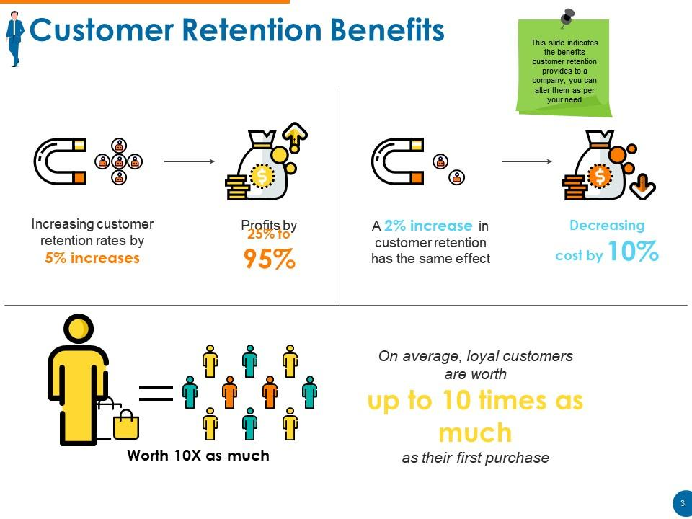

Slide 8
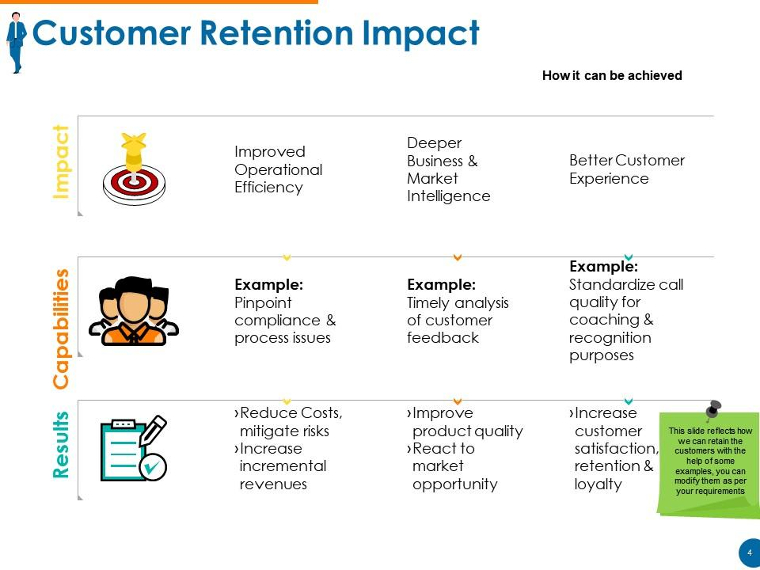

Slide 9
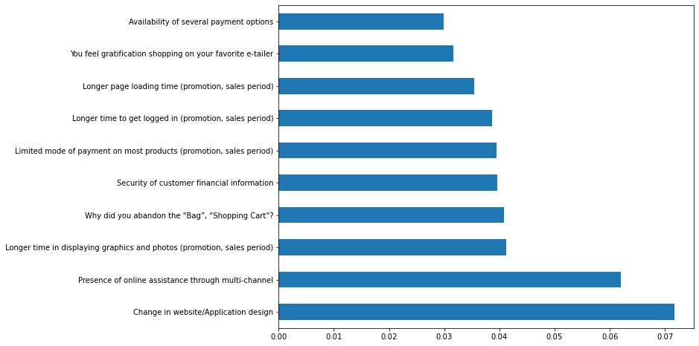
Plot graph of feature importances for better visualization

Slide 10
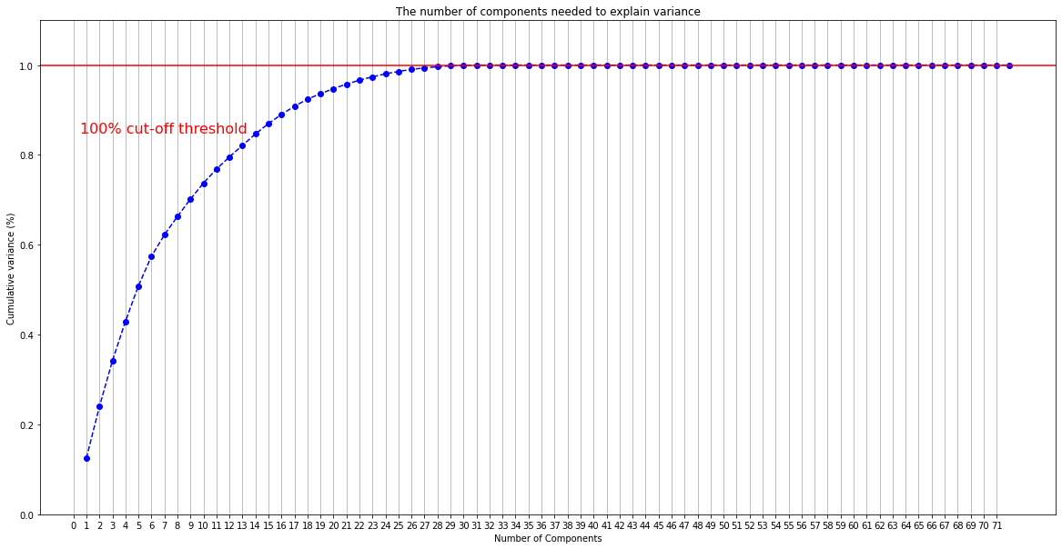
PCA(Principal component Analysis)

Slide 11
Cross Validation Score
Accuracy 1.0
----------------------------------------------------------
Mean of Cross Validation Score 0.9926
----------------------------------------------------------
Confusion Matrix
[[26 0 0 0 0 0 0 0]
[ 0 22 0 0 0 0 0 0]
[ 0 0 4 0 0 0 0 0]
[ 0 0 0 4 0 0 0 0]
[ 0 0 0 0 5 0 0 0]
[ 0 0 0 0 0 7 0 0]
[ 0 0 0 0 0 0 11 0]
[ 0 0 0 0 0 0 0 2]]

Slide 12
Classification Report
Classification Report
precision recall f1-score support
0 1.00 1.00 1.00 26
1 1.00 1.00 1.00 22
2 1.00 1.00 1.00 4
3 1.00 1.00 1.00 4
4 1.00 1.00 1.00 5
5 1.00 1.00 1.00 7
6 1.00 1.00 1.00 11
7 1.00 1.00 1.00 2
accuracy 1.00 81
macro avg 1.00 1.00 1.00 81
weighted avg 1.00 1.00 1.00 81

Slide 13
CONCLUSION
82% of Companies Agree That Customer Retention Is Cheaper Than Acquisition
Retention and acquisition are two of the essential strategies for generating sales.
Although most companies agree that it would be cheaper to retain existing customers, many of them are still focused on acquisition rather than retention.
Econsultancy carried out a Cross-Channel Marketing Study for two years.
Although there was a decrease in the number of companies that focussed on the acquisition, it remained the dominant strategy for most companies.

